Slide 1
Decompensative gravity anomalies reveal the structure of the upper crust of Antarctica.
By C. Haeger^{1,2}, M. Kaban¹
June 4, 2019
¹GFZ German Research Centre for Geosciences, Potsdam, Germany.
²Free University Berlin, Germany.

Slide 2
Part of Project MANTIS I/II
Thermal, density and rheological model of the lithosphere of Antarctica based on the integration of satellite data and its application to the thermal regime of the ice shield
and
Dynamic model of a coupled system of the convecting mantle, lithosphere and ice shield of Antarctica

Slide 3
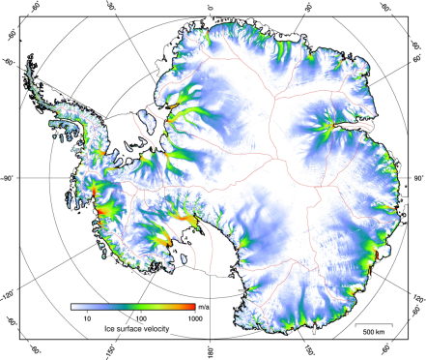
1. Motivation
Temperature
We used gravity data obtain information on flexural rigidity, temperature, density and composition of the Antarctic lithosphere
Uncertainty factor: distribution of low density sediments
Next, we will study the link between crustal structures and ice dynamics
Strongly influenced by presence of sediments
Haeger et al., 2019
Composition
Thermal Density
CompositionalDensity
Effective Elastic Thickness
Ice Flow Velocity
Chen et al., 2018
Göller, 2013 PhD thesis

Slide 4
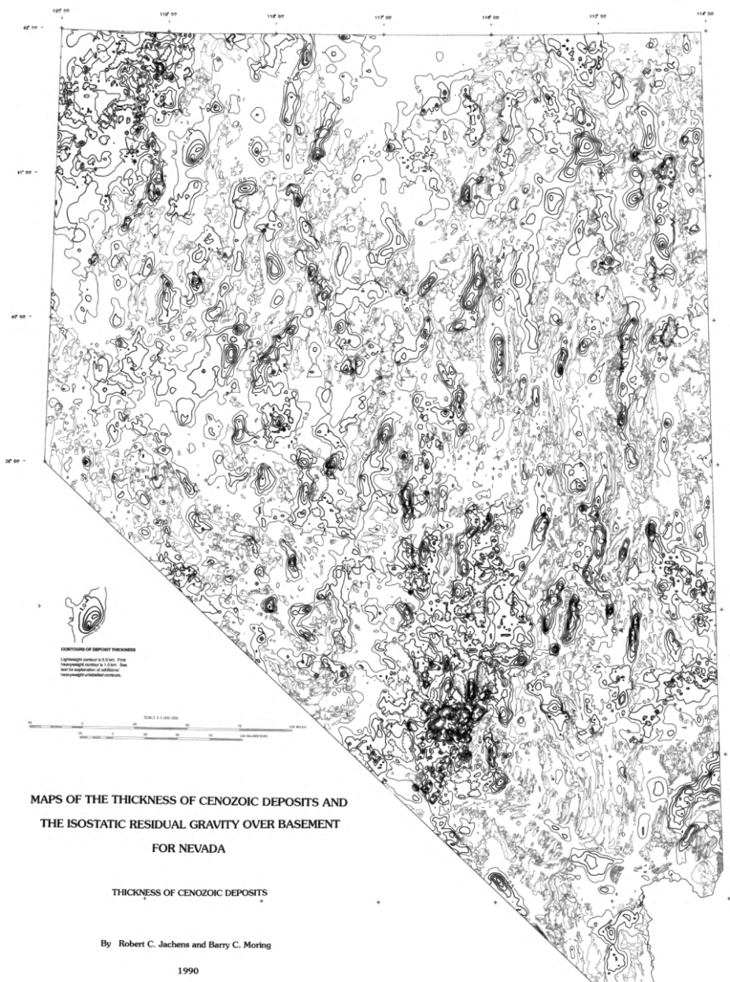
1. Motivation
Isostatic gravity anomalies have been used to infer upper crustal structures and sediment distributions
Compensating masses significantly reduce the gravity effect of unknown upper crustal structures and sedimentary basins
We calculate the so-called decompensative anomalies over the entire Antarctic continent

Slide 5
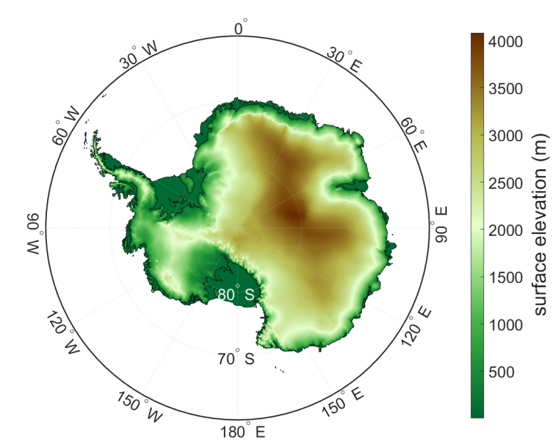
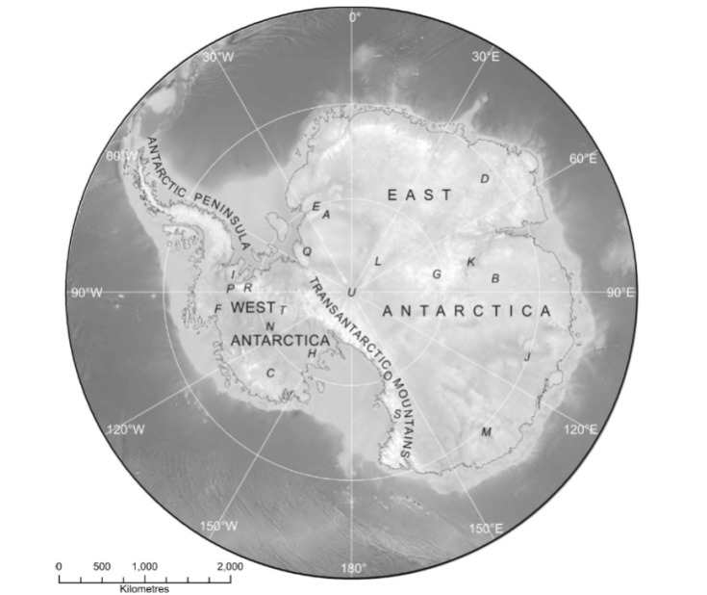
2. Geologic setting
Bedmap2
Fretwell et al., 2013

Slide 6
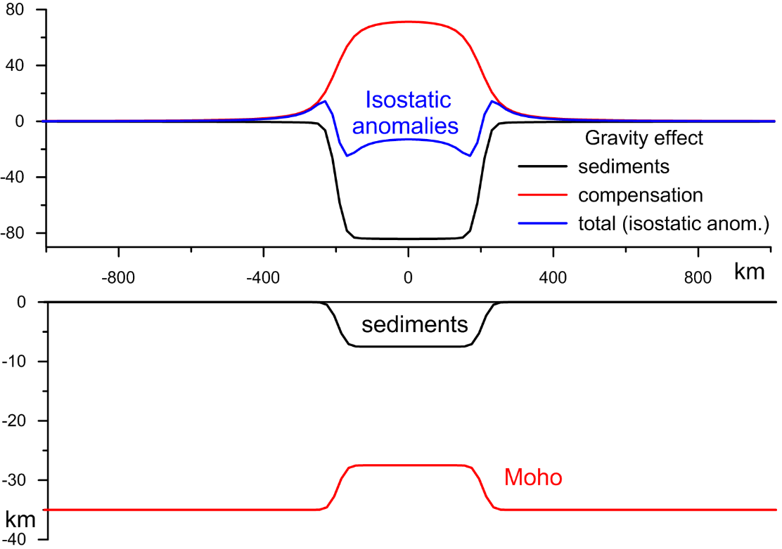
3. Method
$$∆g_{dc}\left(k_{x},k_{y}\right)=\frac{1}{\exp\left(−k∙M\right)/C−1}∙∆g_{i}\left(k_{x},k_{y}\right)$$
$∆g_{d}$=$∆g_{dc}$+$∆g_{i}$
$C=\frac{∆ρg}{k^{4}D+∆ρg}, D=ET_{e}^{3}/[12\left(1−ν^{2}\right)]$

Slide 7
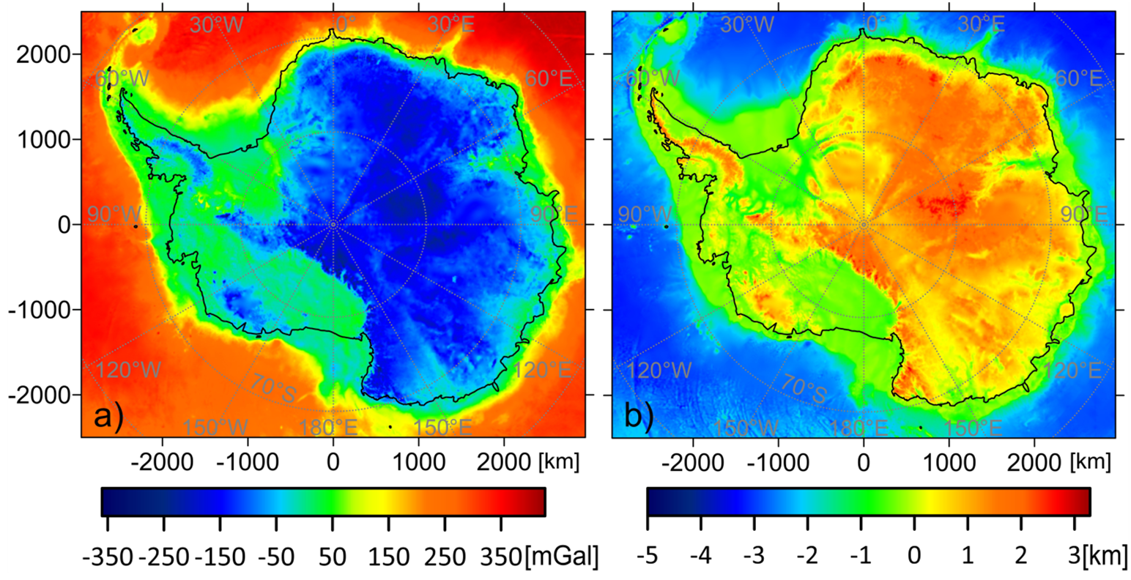
4. Input Data
Bouguer Anomalies
Adjusted Topography
[Haeger and Kaban 2019]

Slide 8
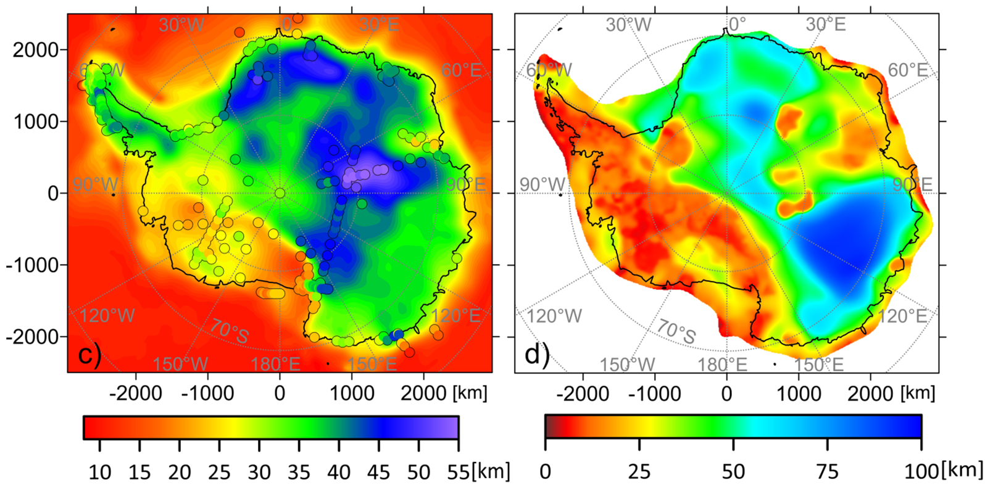
4. Input Data
Moho Depth
Effective Elastic Thickness
[Haeger and Kaban 2019]

Slide 9
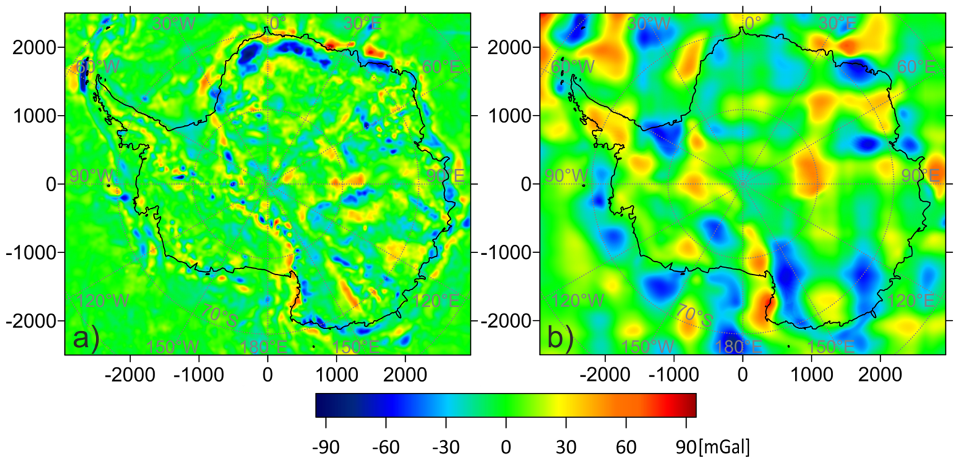
5. Isostatic Anomalies and Decompensative Correction
[Haeger and Kaban 2019]

Slide 10
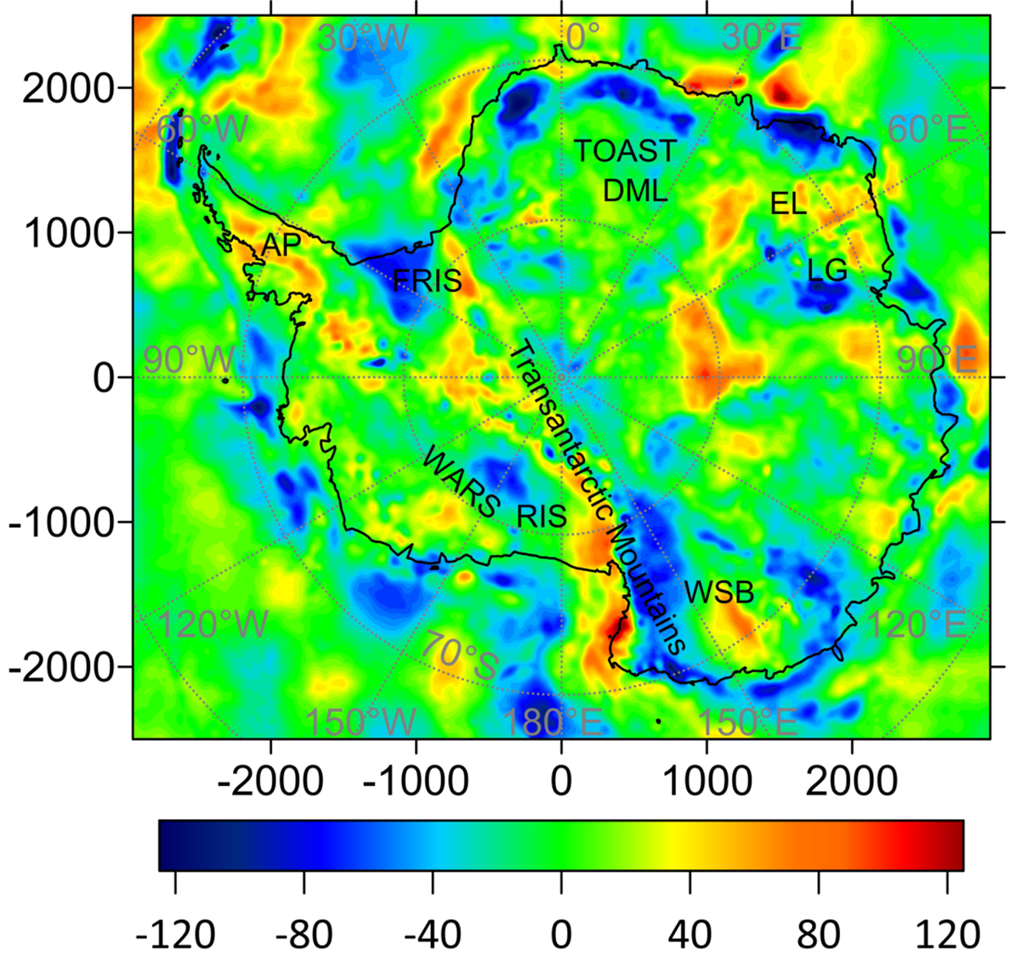
6. Decompensative Anomalies
[Haeger and Kaban 2019]

Slide 11
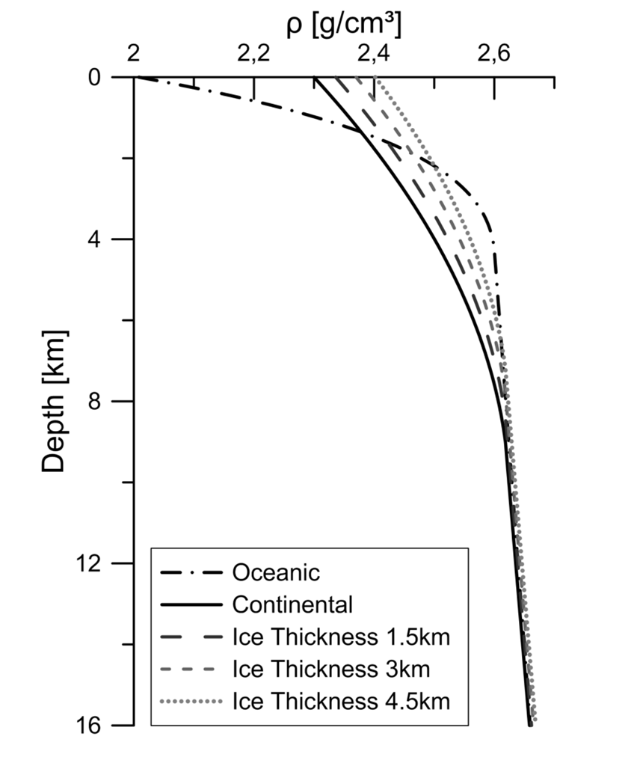
7. Interpretation – Sediment thickness
Sediment thickness estimates by converting negative decompensative anomalies as purely caused by sediments
Variation of density with depth varies for different basins; unknown for Antarctica
Using standard density-depth curves for continental and oceanic basins
Grounded ice causes further compaction
[Haeger and Kaban 2019]

Slide 12
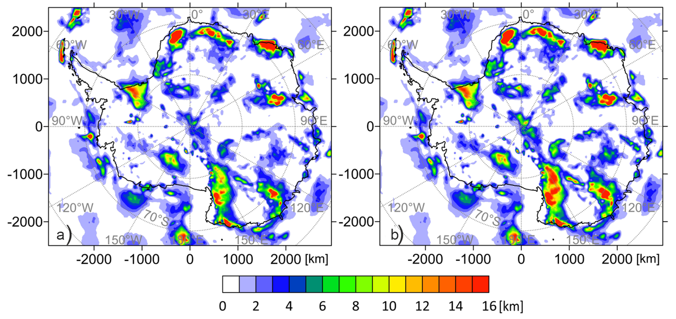
7. Interpretation – Sediment thickness
[Haeger and Kaban 2019]

Slide 13
9. Conclusions
The decompensative correction over Antarctica reaches values of up to ±70mGal. Hence, neglecting this effect would lead to misinterpretation of upper crustal structures.
Negative decompensative anomalies are translated into sediment thickness, which is still largely unknown for Antarctica.
The obtained results depend on unknown density-depth relationships in specific basins.
The sedimentary thickness in the Filchner-Ronne Ice Shelf, the northern Wilkes Subglacial Basin and the Lambert Graben well-corresponds to existing seismic determinations, which confirms reliability of the results.
Further sedimentary deposits that were previously not or only partially mapped are detected in both EANT and WANT.

Slide 14
3. Data - Gravity
EIGEN-6c4
Combination of satellite (GRACE, GOCE, LAEGOS) and terrestrial data
Resolution: ~200km
AntGG
Compilation of terrestrial (mainly airborne) data
Resolution: up to 10km
Förste et al., 2014
Scheinert et al., 2016

Slide 15
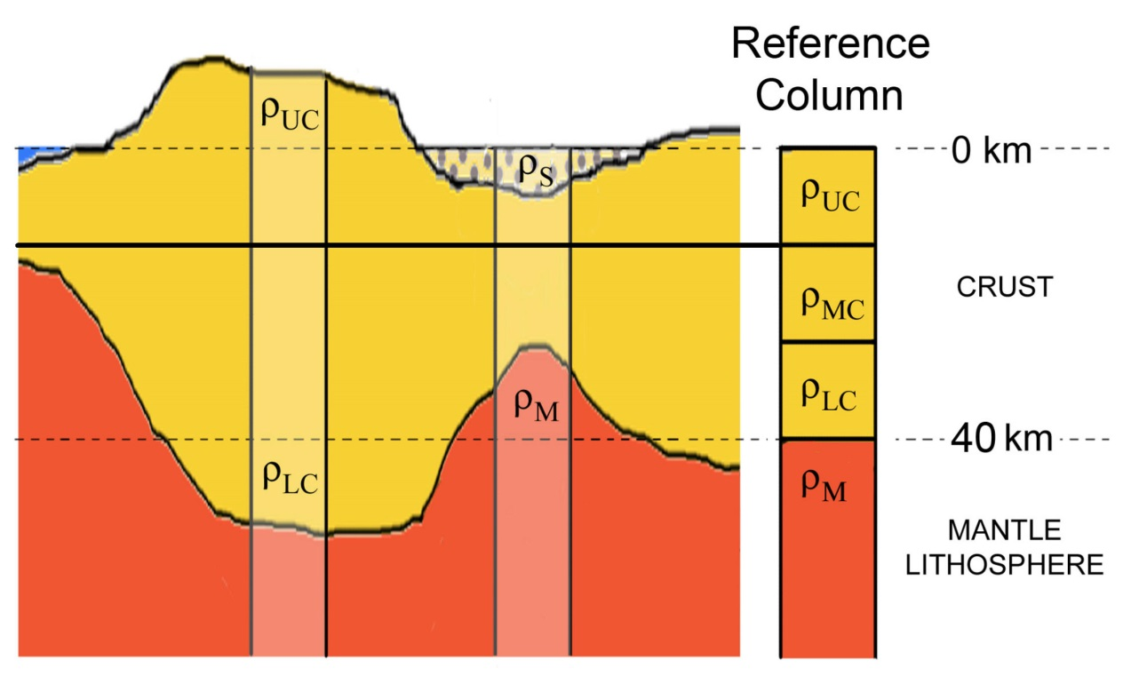
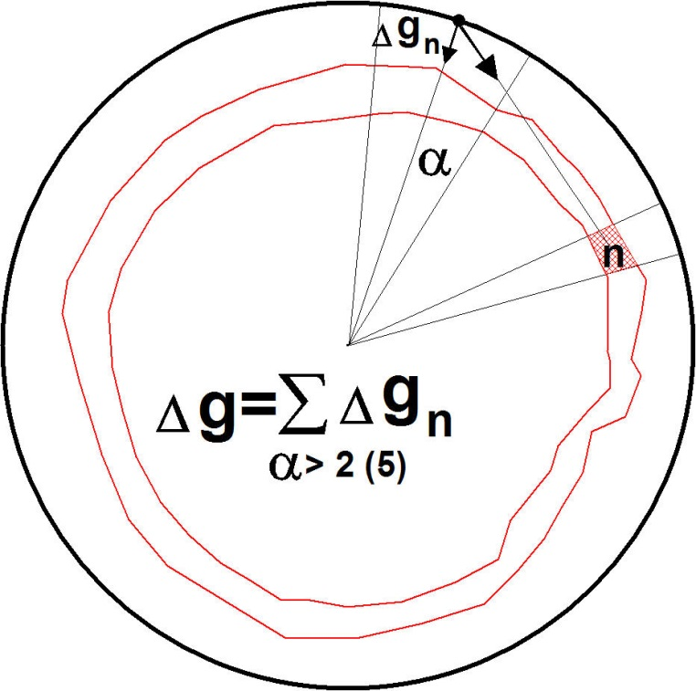
Gravity calculations

Slide 16
Gravity modeling
Freeair
Bedrock
Residual
Ice
Water
Residual Gravity Disturbance
Freeair Gravity Disturbence
Gravity Effect - Topography
Gravity Effect - Water
Gravity Effect - Ice

