Slide 1




Polar-night Jet Oscillations (PJOs) and their impact on the MLT dynamics
J. Federico Conte, Jorge L. Chau, Dieter H. W. Peters
4th Colloquium SPP Dynamic Earth. Bad Aibling, 2019

Slide 2
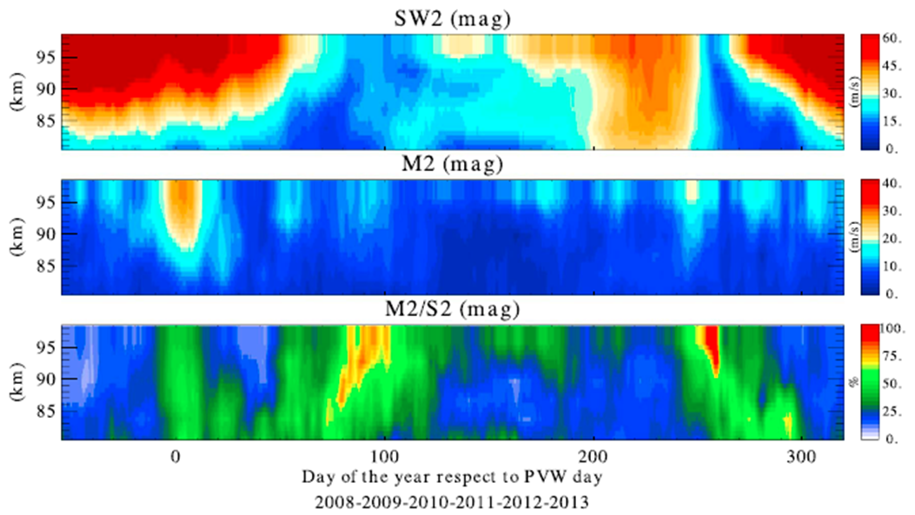
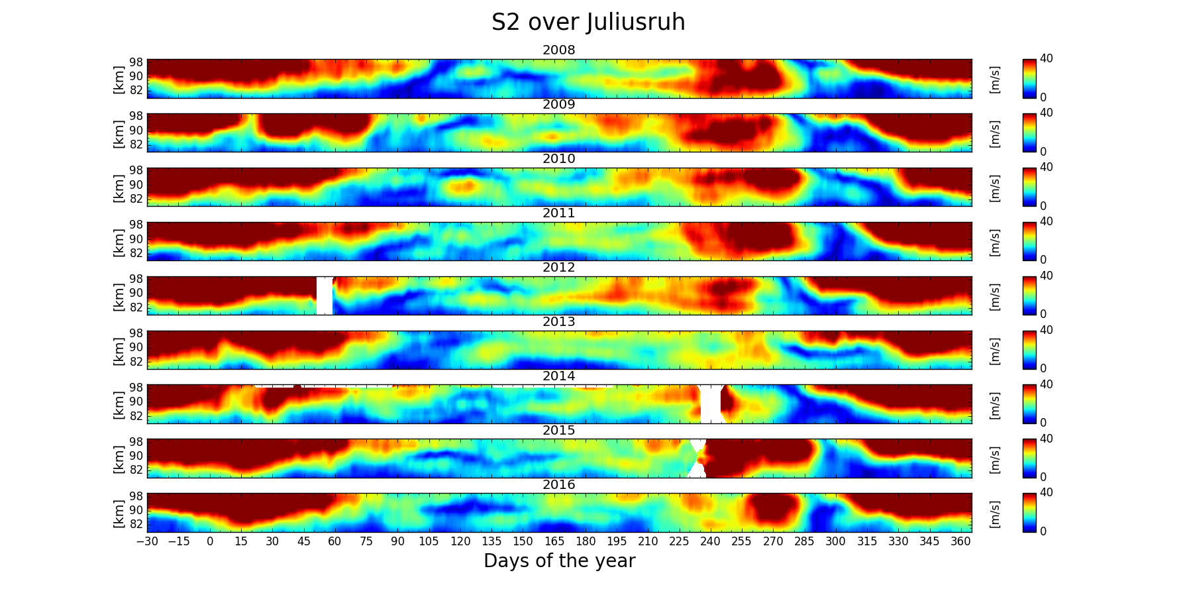
DYNAMITE 1 - Results
Ten (10) publications resulted from our efforts during the first phase:
Baumgarten et al. (2017), JGR Atmospheres.
Baumgarten et al. (2018), ACP.
Chau et al. (2015), JGR Space Phys.
Conte et al. (2017), JGR Space Phys.
Conte and Brunini (2017), Adv. Space Res.
Conte et al. (2018), AnnGeo.
He et al. (2017), JGR Space Phys.
Hysell et al. (2017), JGR Space Phys.
Pedatella et al. (2014), JGR Space Phys.
Pedatella et al. (2018), EOS.
Results presented and discussed in these articles, as well as the fact that the vertical coupling between different layers of the atmosphere is still not entirely understood, motivated us to further investigate, and eventually write the second phase of our project…
4th Colloquium SPP Dynamic Earth. Bad Aibling, 2019

Slide 3
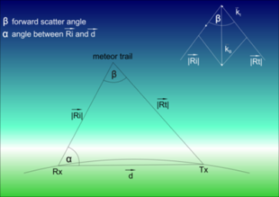

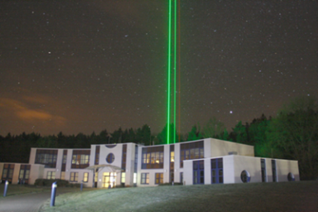
DYNAMITE 2 – Main goals of the project
Quantification of the GW activity and their corresponding momentum flux in the MLT region with radar and lidar observations at middle and high latitudes, with special focus on fall transition times.
Investigation of the interactions of PWs, mean winds and tides, in the MLT region and their relation to thermospheric parameters as observed by Swarm and other satellite data (e.g., CHAMP, GRACE, GOCE, COSMIC) at middle and high latitudes.
Investigation of tides, GWs and mean winds in the MLT region during PJOs and their relation to its strength and temporal extent, using observations and simulations.
Evaluation of the observed MLT tides during PJO and non PJO events on the I/T weather, by comparing special WACCM-X simulations with satellite and ground-based I/T observations.
4th Colloquium SPP Dynamic Earth. Bad Aibling, 2019

Slide 4
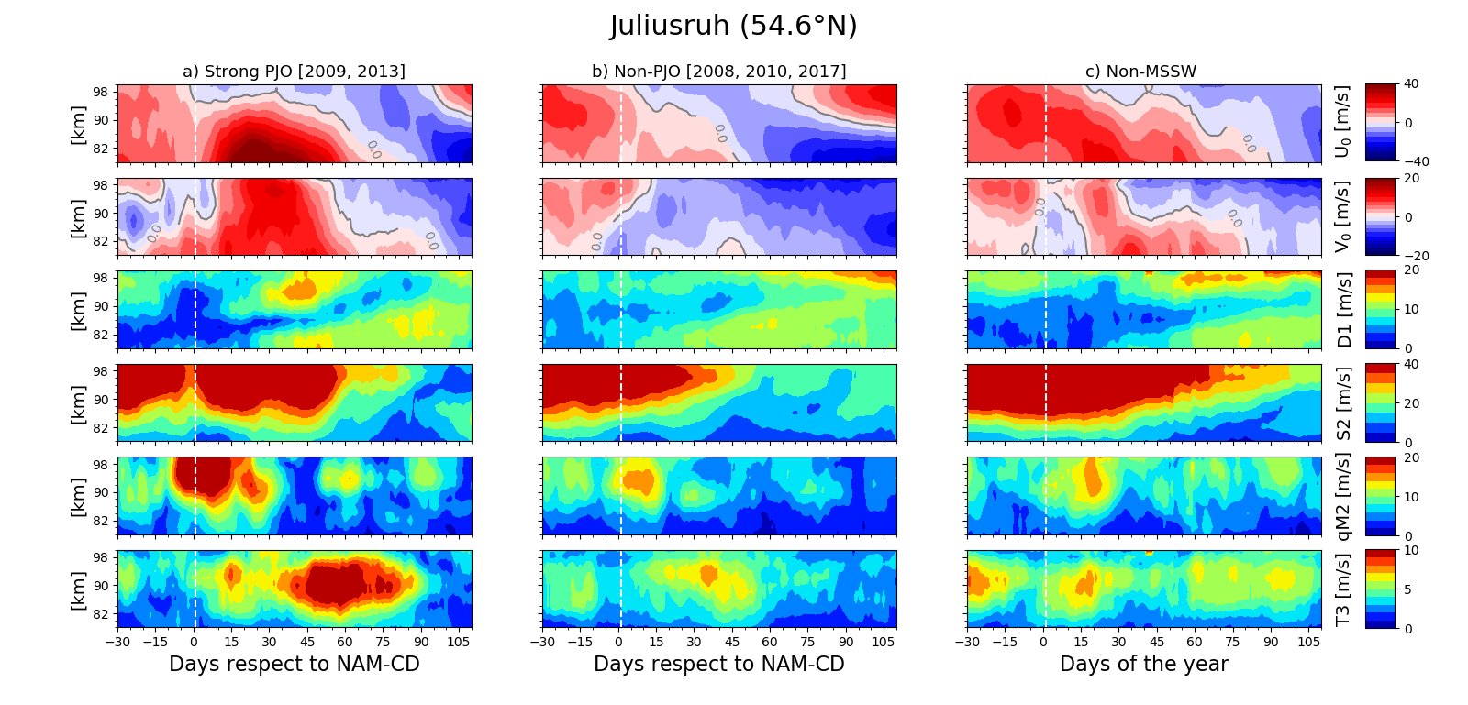
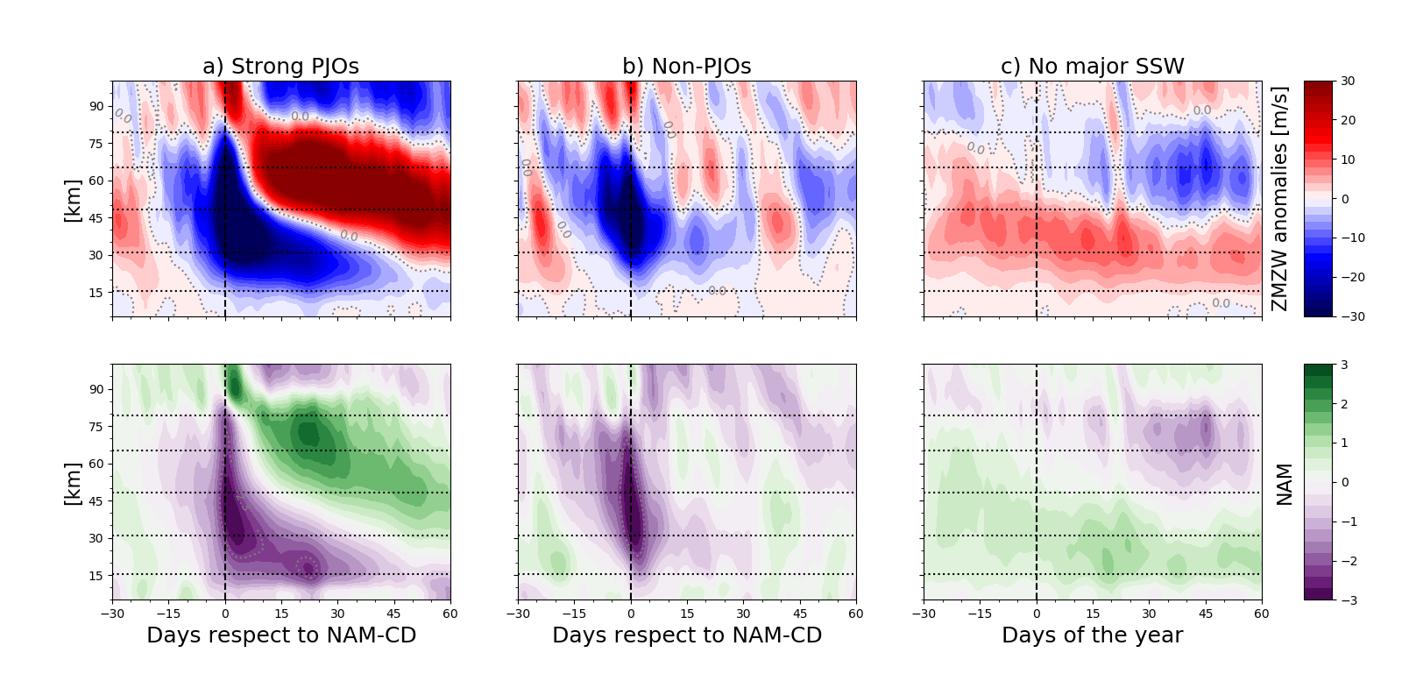
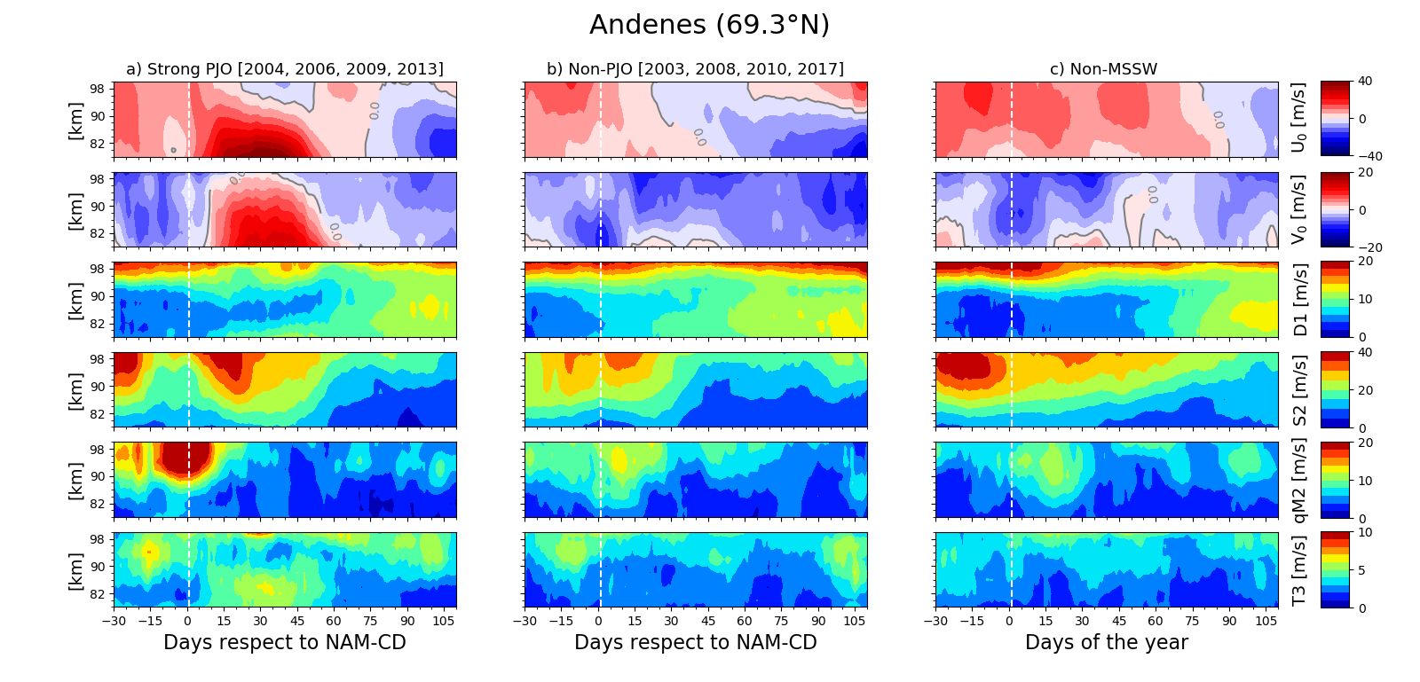
Response of the MLT to PJO events
*Adapted from Conte et al. (2019), JGR (minor revision)
Ext-CMAM30 simulations
Specular meteor radars
4th Colloquium SPP Dynamic Earth. Bad Aibling, 2019
Notes:
During sPJOs winter, compared to nPJOs, the mid-latitude and high latitudes MLT dynamics show based on visual inspection: possibly
Lunar tide occurs earlier, accompanied by a weaker SW2
Why, no idea, should be linked ZMZW anomaly structure?
Significant changes around Feb/Mar:
Strong PJO years have a longer persistent PV up to two months, link to tides and summer wind reversal unclear?
In Diurnal tide at mid latitudes
In mean winds at high latitudes
Altitude and time of the zonal wind reversal changes around April/May.
From Wavelet analysis …?? Why needed?
Polar Night Jet Stratospheric influences in “future” MLT dynamics?
First guess: stronger PJO means stronger PV in February-March, longer lasting winter, later summer in this sense we could argue or ?

Slide 5
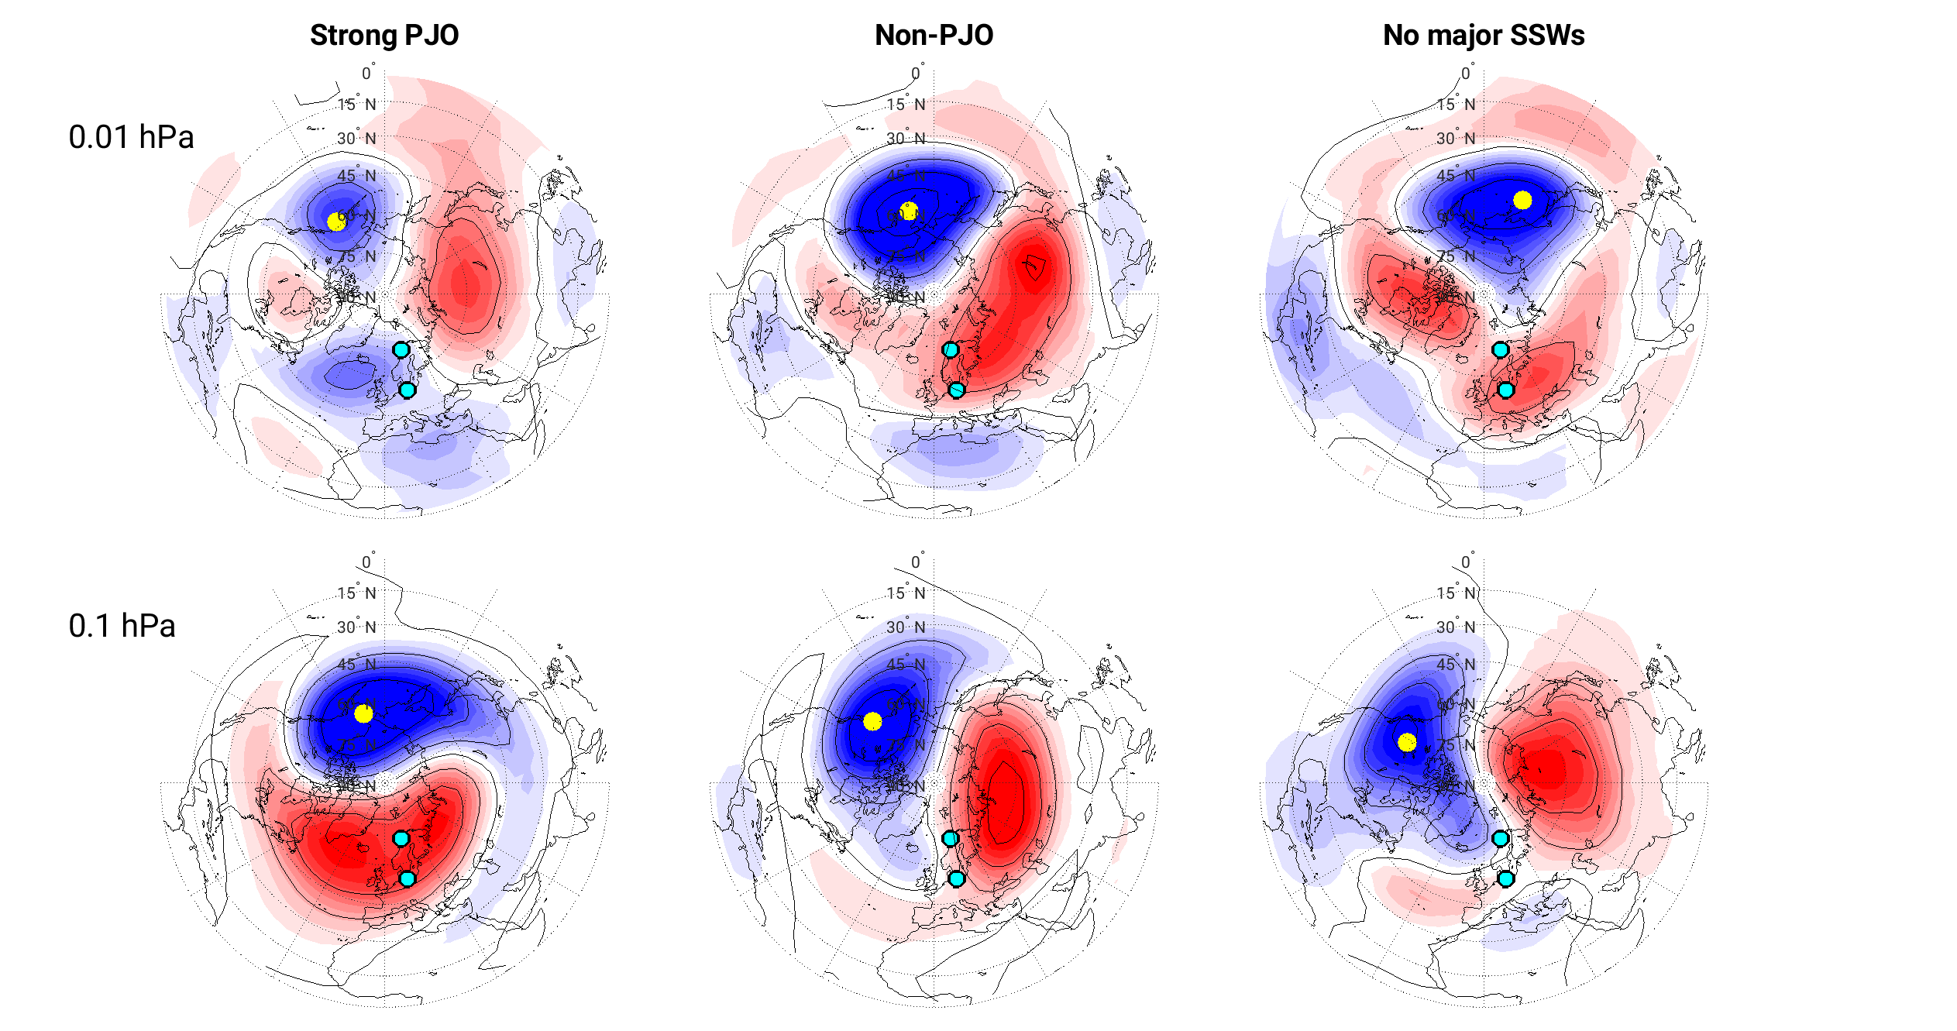
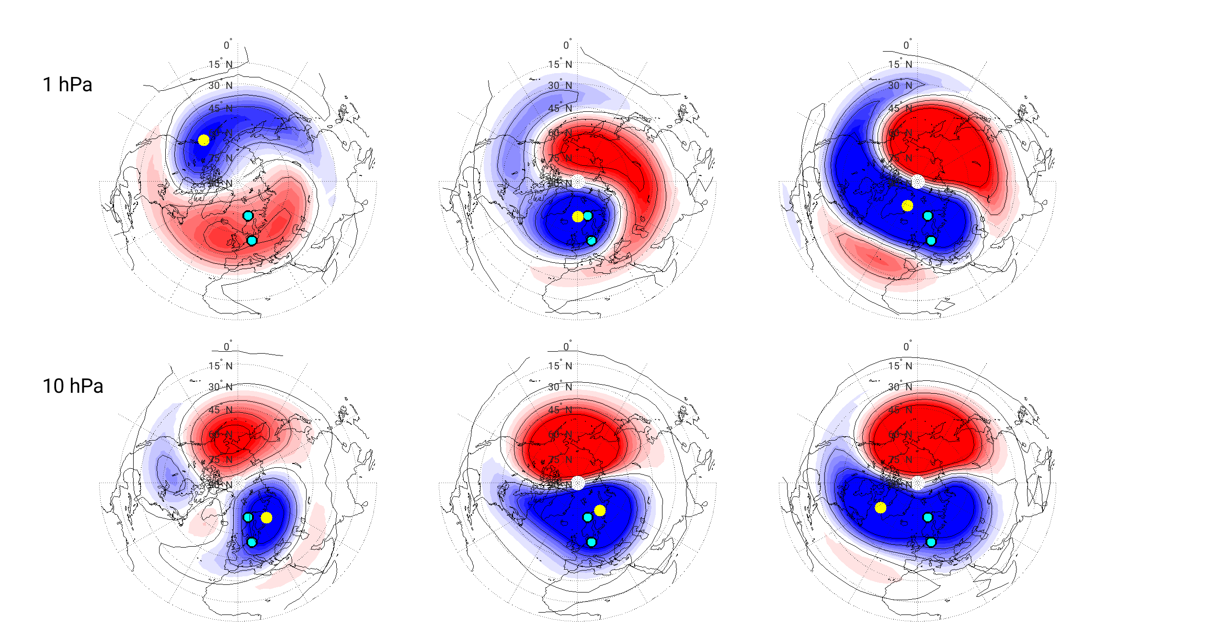
Response of the MLT to PJO events
We are also extending to other locations, in order to further understand this type of phenomena. For example, using a network of specular meteor radars located in very similar latitudes but at different longitudinal sectors.
Please visit Maosheng’s poster
(tomorrow morning)
4th Colloquium SPP Dynamic Earth. Bad Aibling, 2019
Notes:
During sPJOs winter, compared to nPJOs, the mid-latitude and high latitudes MLT dynamics show based on visual inspection: possibly
Lunar tide occurs earlier, accompanied by a weaker SW2
Why, no idea, should be linked ZMZW anomaly structure?
Significant changes around Feb/Mar:
Strong PJO years have a longer persistent PV up to two months, link to tides and summer wind reversal unclear?
In Diurnal tide at mid latitudes
In mean winds at high latitudes
Altitude and time of the zonal wind reversal changes around April/May.
From Wavelet analysis …?? Why needed?
Polar Night Jet Stratospheric influences in “future” MLT dynamics?
First guess: stronger PJO means stronger PV in February-March, longer lasting winter, later summer in this sense we could argue or ?

Slide 6
Response of the MLT to PJO events - Summary
4th Colloquium SPP Dynamic Earth. Bad Aibling, 2019
Notes:
During sPJOs winter, compared to nPJOs, the mid-latitude and high latitudes MLT dynamics show based on visual inspection: possibly
Lunar tide occurs earlier, accompanied by a weaker SW2
Why, no idea, should be linked ZMZW anomaly structure?
Significant changes around Feb/Mar:
Strong PJO years have a longer persistent PV up to two months, link to tides and summer wind reversal unclear?
In Diurnal tide at mid latitudes
In mean winds at high latitudes
Altitude and time of the zonal wind reversal changes around April/May.
From Wavelet analysis …?? Why needed?
Polar Night Jet Stratospheric influences in “future” MLT dynamics?
First guess: stronger PJO means stronger PV in February-March, longer lasting winter, later summer in this sense we could argue or ?

Slide 7
Thank you!

Slide 8
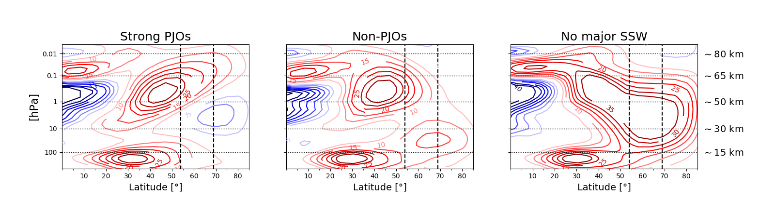
Notes:
During sPJOs winter, compared to nPJOs, the mid-latitude and high latitudes MLT dynamics show based on visual inspection: possibly
Lunar tide occurs earlier, accompanied by a weaker SW2
Why, no idea, should be linked ZMZW anomaly structure?
Significant changes around Feb/Mar:
Strong PJO years have a longer persistent PV up to two months, link to tides and summer wind reversal unclear?
In Diurnal tide at mid latitudes
In mean winds at high latitudes
Altitude and time of the zonal wind reversal changes around April/May.
From Wavelet analysis …?? Why needed?
Polar Night Jet Stratospheric influences in “future” MLT dynamics?
First guess: stronger PJO means stronger PV in February-March, longer lasting winter, later summer in this sense we could argue or ?

